Slide 1

National University of Computer and Emerging Sciences,
Islamabad, Pakistan
Introduction to Convolutional Neural Networks
DS-5006: Deep Learning
Dr. Noshina Tariq
Department of AI and DS

Slide 2
Goals
Review of Previous Lecture
Today’s Lecture
Introduction to Convolutional Neural Networks

Slide 3
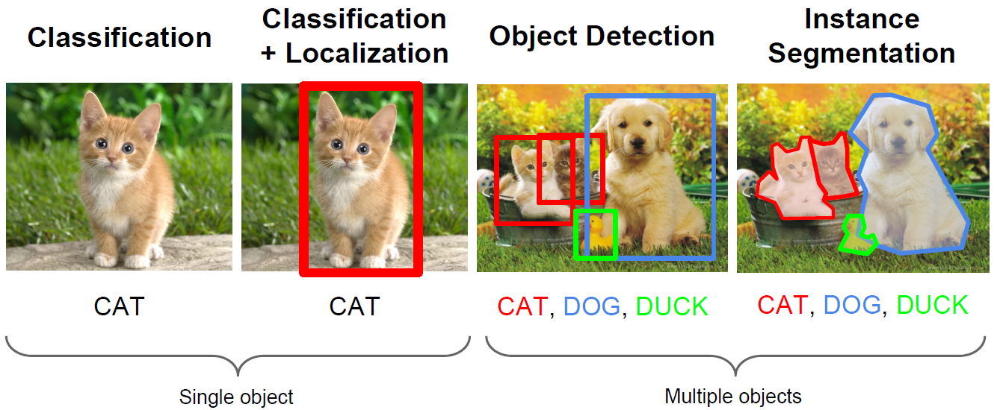
Computer Vision Tasks
Computer vision has been the primary area of interest for ML
The tasks include: classification, localization, object detection, instance segmentation

Slide 4
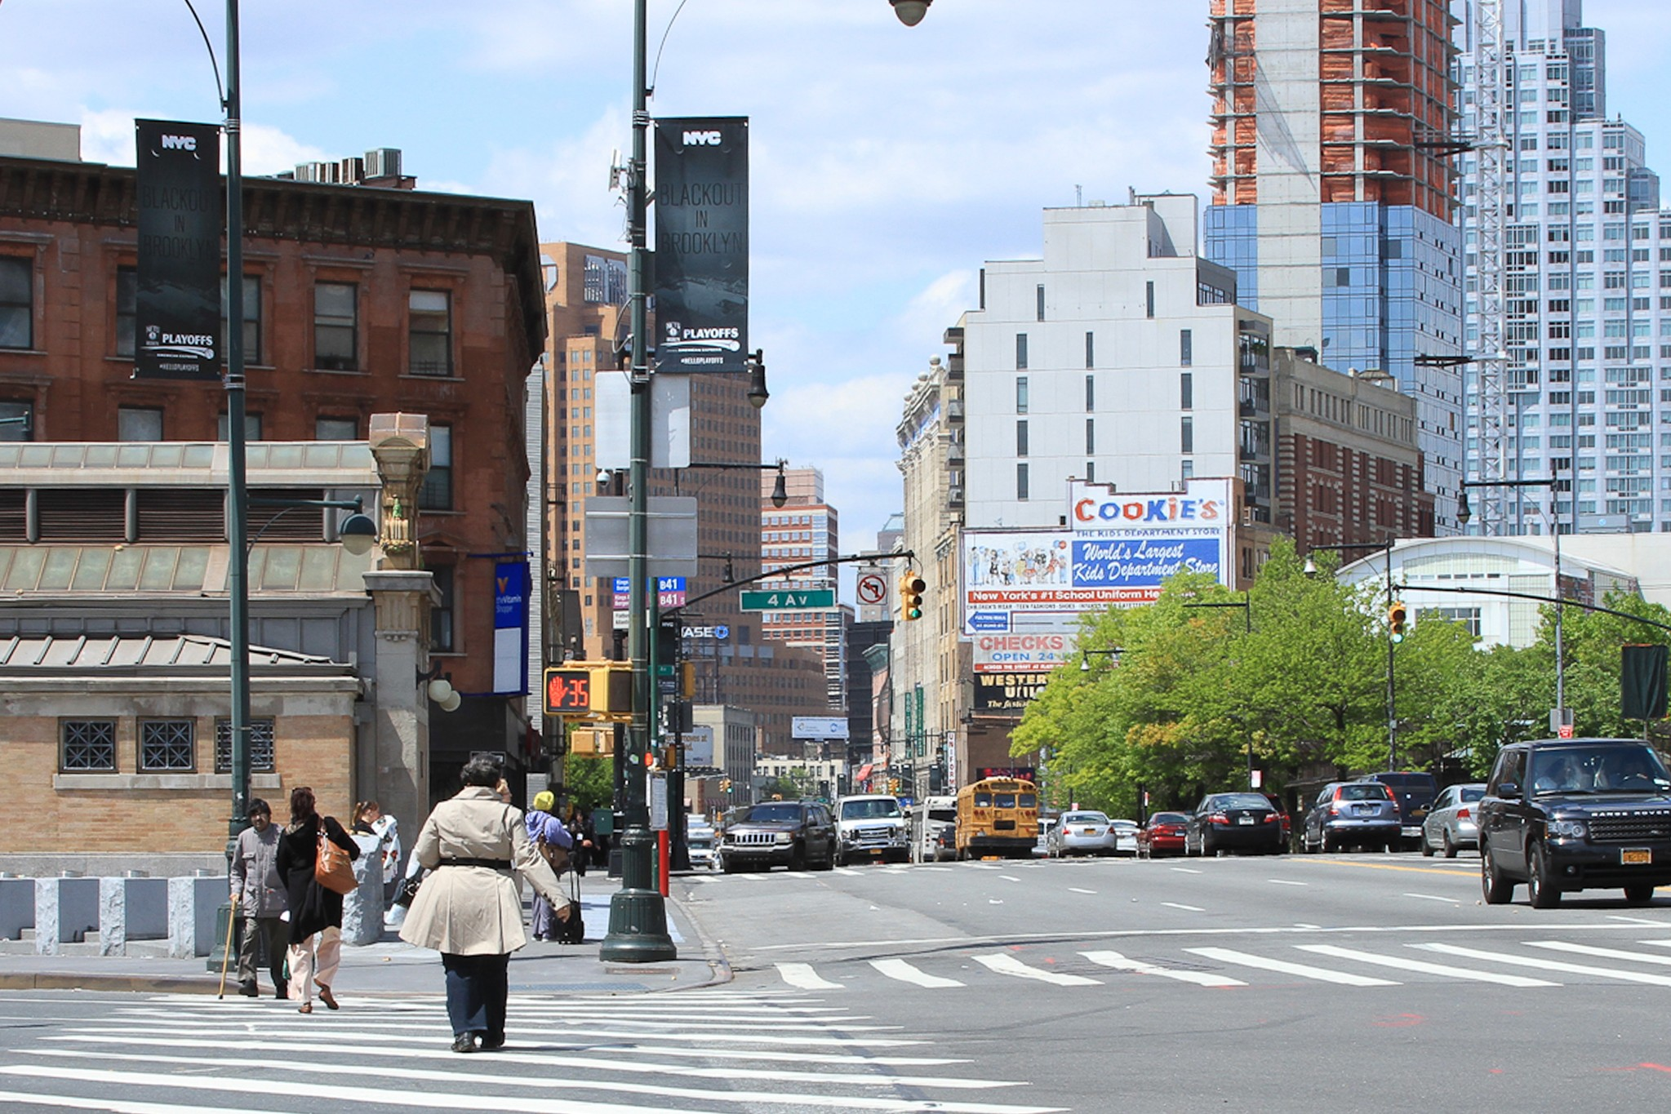
What do you see?

Slide 5
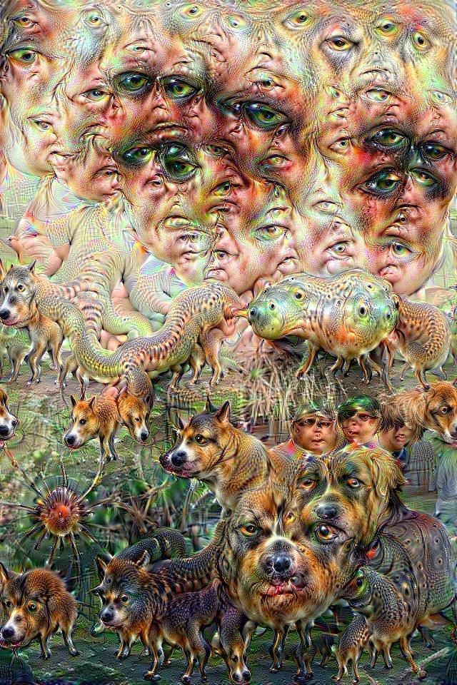
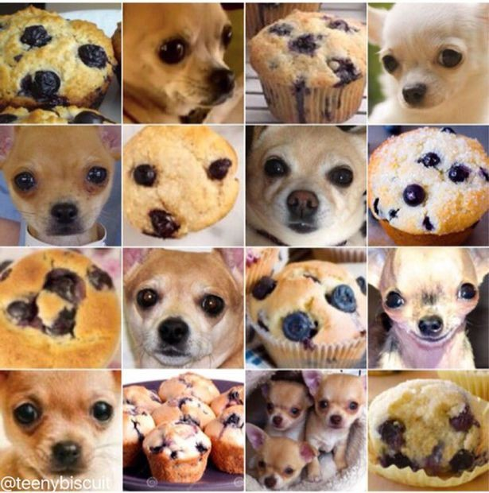
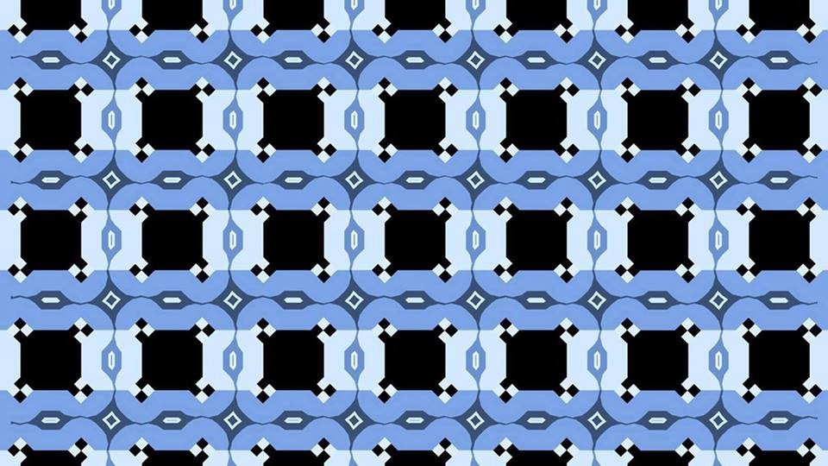
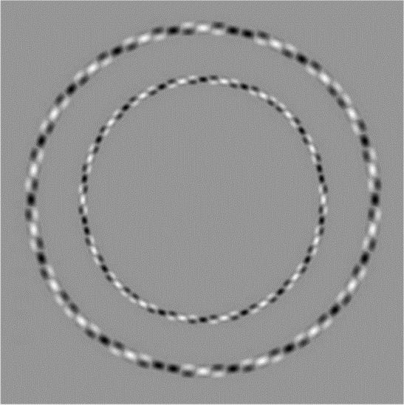
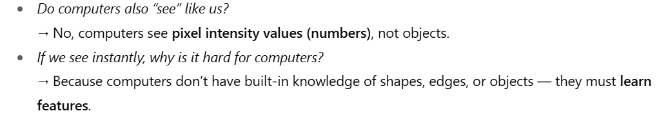

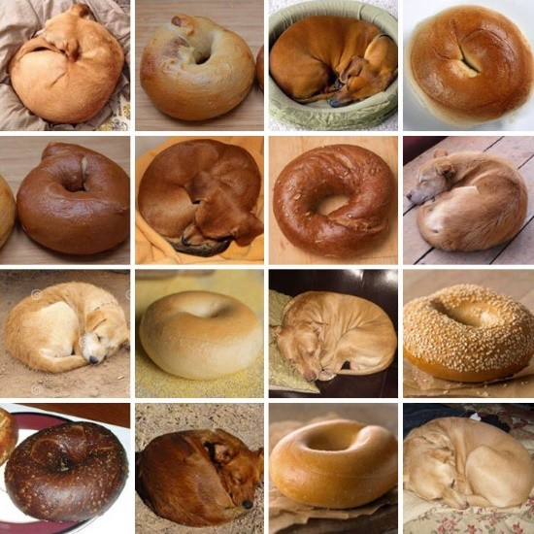
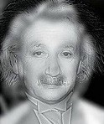
How do you see?
How can we help computers see?

Slide 6

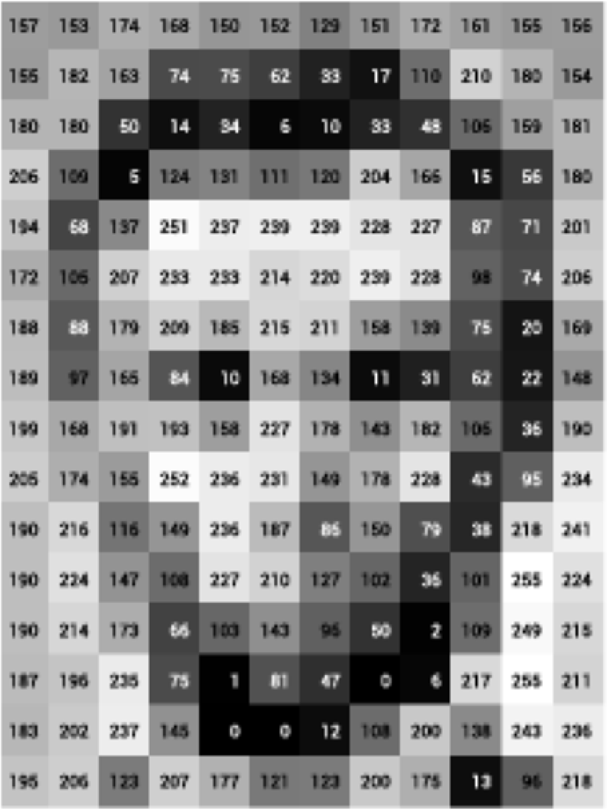
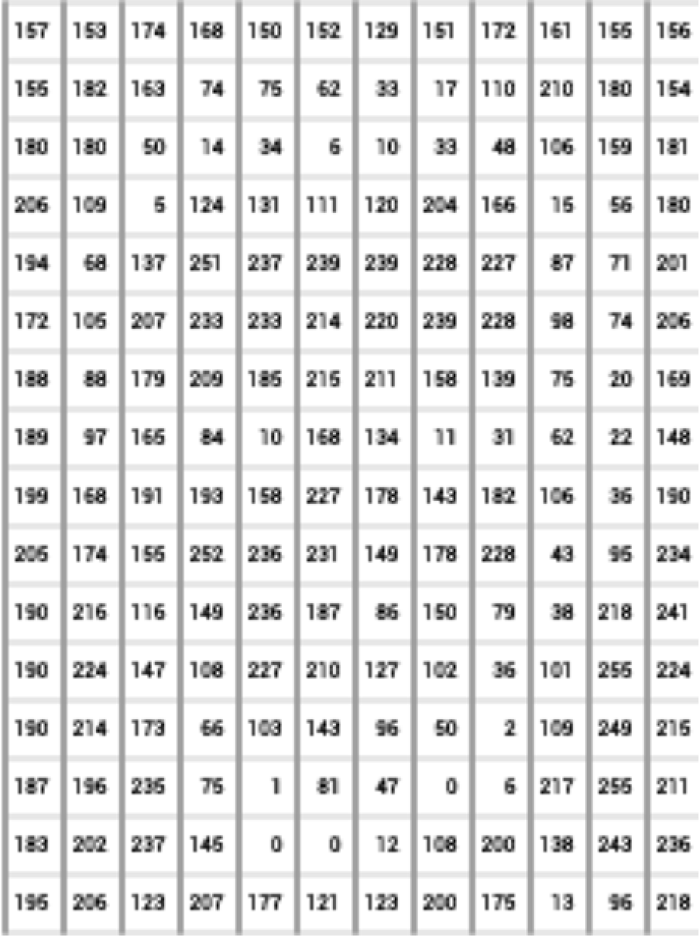
What computers ‘see’: Images as Numbers
What you see What you both see What the computer "sees"
Levin Image Processing & Computer Vision
Input Image Input Image + values
Pixel intensity values (“pix-el”=picture-element)
An image is just a matrix of numbers [0,255]. i.e., 1080x1080x3 for an RGB image.
Question: is this Lincoln? Washington? Jefferson? Obama?
How can the computer answer this question?
Can I just do classification on the 1,166400-long image vector directly?
No. Instead: exploit image spatial structure. Learn patches. Build them up

Slide 7
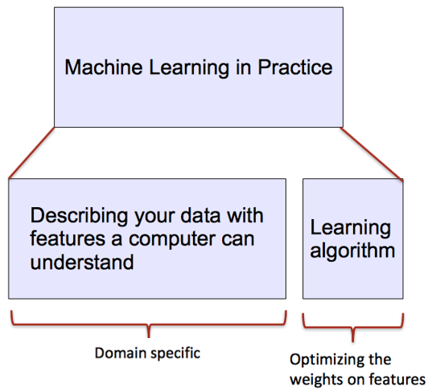
ML vs. Deep Learning
Introduction to Deep Learning
Conventional machine learning methods rely on human-designed feature representations
ML becomes just optimizing weights to best make a final prediction

Slide 8

ML vs. Deep Learning
Introduction to Deep Learning
Deep learning (DL) is a machine learning subfield that uses multiple layers for learning data representations
DL is exceptionally effective at learning patterns
Picture from: https://www.xenonstack.com/blog/static/public/uploads/media/machine-learning-vs-deep-learning.png

Slide 9
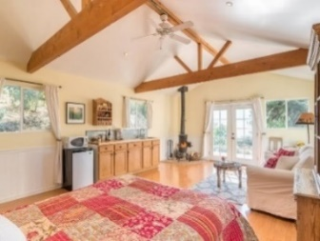


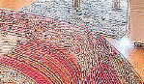
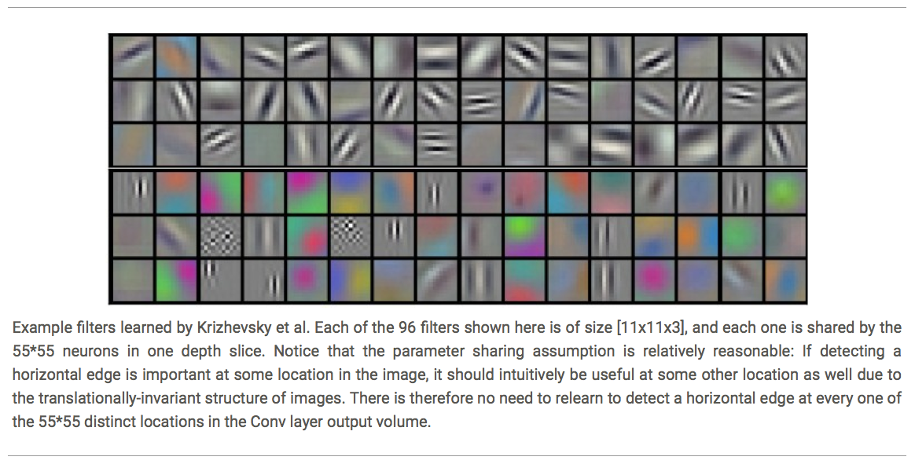
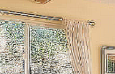



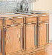









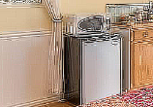
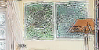
ML vs. Deep Learning
Introduction to Deep Learning
DL applies a multi-layer process for learning rich hierarchical features (i.e., data representations)
Input image pixels → Edges → Textures → Parts → Objects
Low-Level Features
Mid-Level Features
High-Level Features
Trainable Classifier
Output

Slide 10
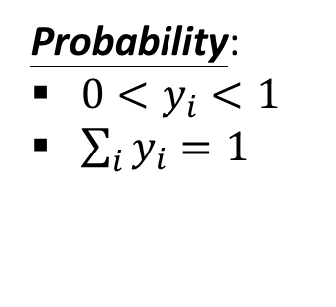
Softmax Layer
Introduction to Neural Networks
After the CNN extracts features and passes them through hidden layers, the network needs to make a final decision.
But raw outputs (called logits) can be any real number (negative, positive, very large).We need a way to convert them into probabilities (between 0 and 1, and sum = 1).
A Softmax Layer
Probability:
$0<y_{i}<1$
$\sum_{i}{y_{i}=1}$
3
20
0.88
1
2.7
0.12
-3
0.05
≈0

Slide 11
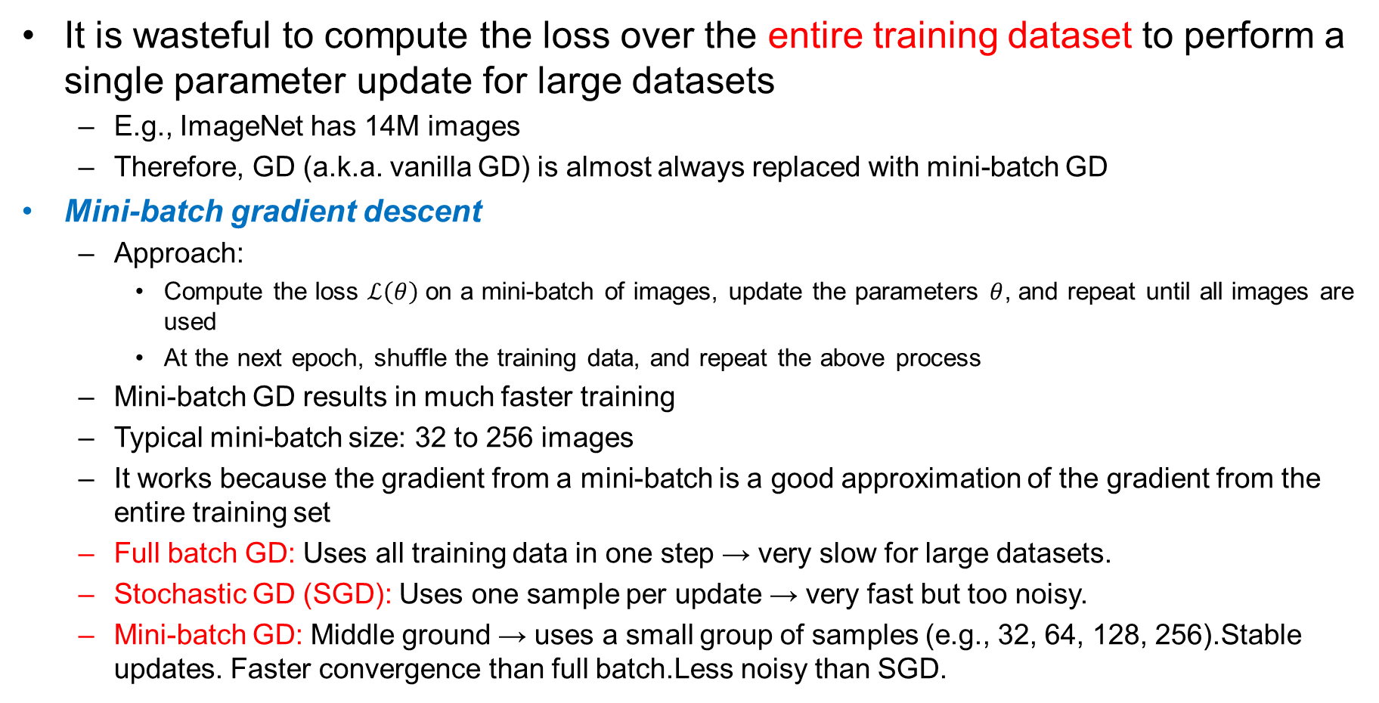
Mini-batch Gradient Descent
Training Neural Networks
It is wasteful to compute the loss over the entire training dataset to perform a single parameter update for large datasets
E.g., ImageNet has 14M images
Therefore, GD (a.k.a. vanilla GD) is almost always replaced with mini-batch GD
Mini-batch gradient descent
Approach:
Compute the loss $ℒ\left(θ\right)$ on a mini-batch of images, update the parameters $θ$, and repeat until all images are used
At the next epoch, shuffle the training data, and repeat the above process
Mini-batch GD results in much faster training
Typical mini-batch size: 32 to 256 images
It works because the gradient from a mini-batch is a good approximation of the gradient from the entire training set
Full batch GD: Uses all training data in one step → very slow for large datasets.
Stochastic GD (SGD): Uses one sample per update → very fast but too noisy.
Mini-batch GD: Middle ground → uses a small group of samples (e.g., 32, 64, 128, 256).Stable updates. Faster convergence than full batch.Less noisy than SGD.

Slide 12
Stochastic Gradient Descent
Training Neural Networks
Stochastic gradient descent
SGD uses mini-batches that consist of a single input example
E.g., one image mini-batch
Although this method is very fast, it may cause significant fluctuations in the loss function
Therefore, it is less commonly used, and mini-batch GD is preferred
In most DL libraries, SGD typically means a mini-batch GD (with an option to add momentum)

Slide 13
Feature Engineering
Feature engineering is the process of selecting, manipulating, and transforming raw data into valuable features.
To apply Machine Learning.
It might be necessary to design and train better features.
Converting raw observations into desired features
Enhancing model accuracy

Slide 14
Why Deep Learning Now?
Artificial Intelligence is decades old
Breakthroughs in the field of artificial neural networks are exploding the deep learning.
Deep learning got boom in recent times
Companies use advanced computational techniques to find useful information hidden in huge data.

Slide 15

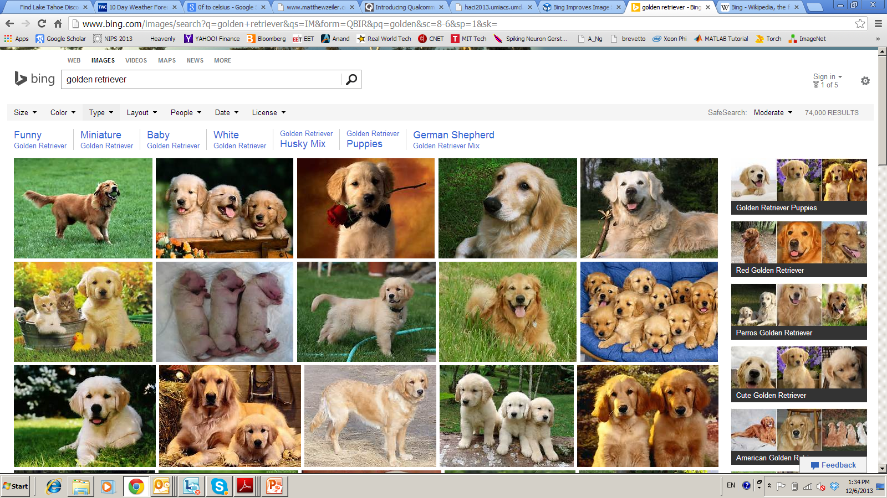


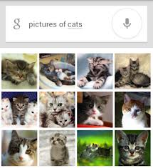

Deep Learning – from Research to Technology
Deep Learning - breakthrough in visual and speech recognition

Slide 16

Classical Computer Vision Pipeline

Slide 17
Deep Learning –based Vision Pipeline.
Deep Learning:
Build features automatically based on training data
Combine feature extraction and classification
DL experts: define NN topology and train NN
Deep NN...
Detection,
Classification
Recognition
Deep Learning promise:
obtain good feature automatically,
We can apply same method for other problems

Slide 18
Introduction to Convolutional Neural Networks

Slide 19
What are CNNs ?
CNN = Neural Network with a convolution operation
Convolutional neural networks (CNN, ConvNet) is a class of deep, feed-forward artificial neural networks that are applied to analyzing visual imagery.
Consists of Matrix Multiplication in at least one of the layers

Slide 20


Consider learning an image:
Some patterns are much smaller than the whole image
Can represent a small region with fewer parameters
“beak” detector

Slide 21

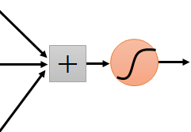
Same pattern appears in different places: They can be compressed! What about training a lot of such “small” detectors and each detector must “move around”.
“upper-left beak” detector
They can be compressed
to the same parameters.
“middle beak” detector

Slide 22
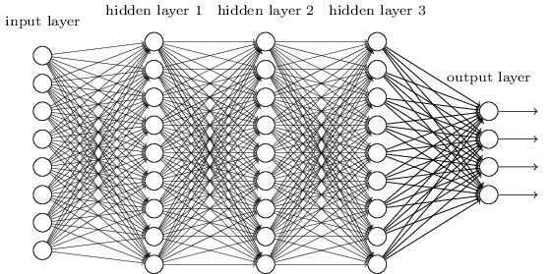
Smaller Network: CNN
We know it is good to learn a small model.
From this fully connected model, do we really need all the edges?
Can some of these be shared?

Slide 23

Convolutional Neural Networks (CNNs)
Feature extraction architecture
After 2 convolutional layers, a max-pooling layer reduces the size of the feature maps (typically by 2)
A fully convolutional and a softmax layers are added last to perform classification
Convolutional Neural Networks
Living Room
Bedroom
64
64
128
128
256
256
256
512
512
512
512
512
512
Kitchen
Bathroom
Conv layer
Max Pool
Outdoor
Fully Connected Layer
Slide credit: Param Vir Singh – Deep Learning

Slide 24
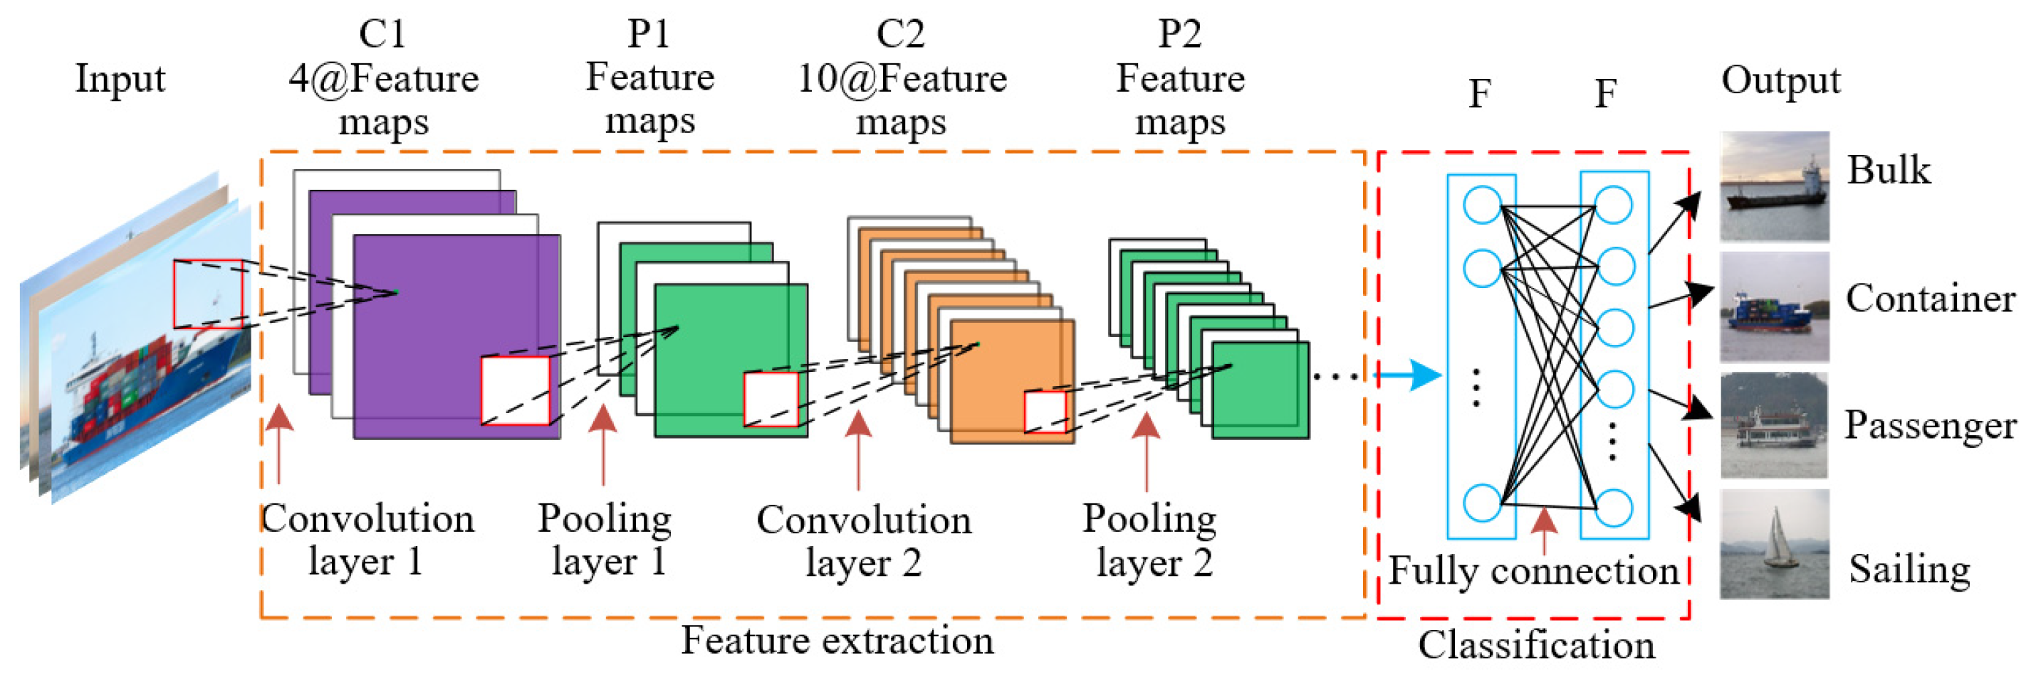
CNN architecture

Slide 25
Convolutional Neural Networks (CovNet)
In a nutshell, A ConvNet usually has 3 types of layers: 1) Convolutional Layer (CONV) 2) Pooling Layer (POOL) 3) Fully Connected Layer (FC)

Slide 26
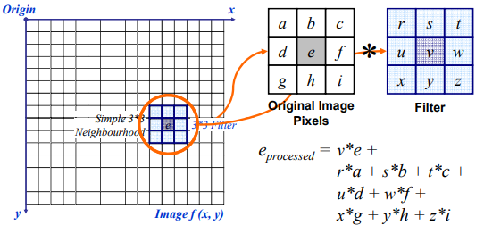
Convolution Operation

Slide 27
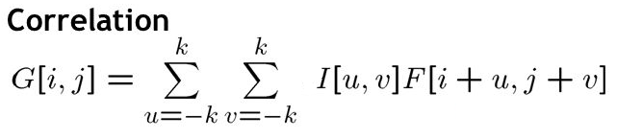
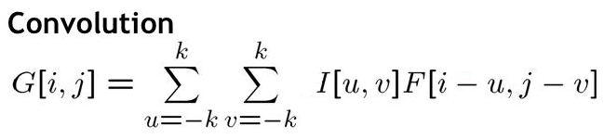
Convolution Operation
G[i,j]=u=-kk v=-kk I[u,v]F[i+u,j+v]
Convolution and Correlation

Slide 28
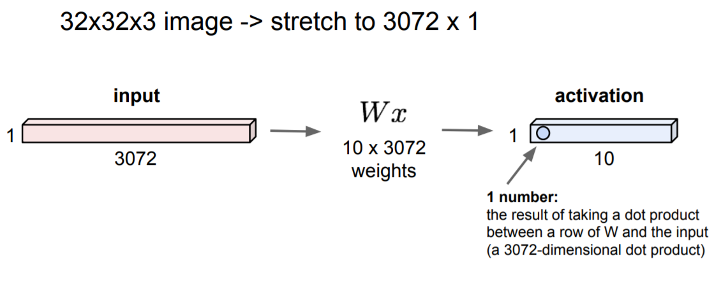
Fully Connected Layer

Slide 29
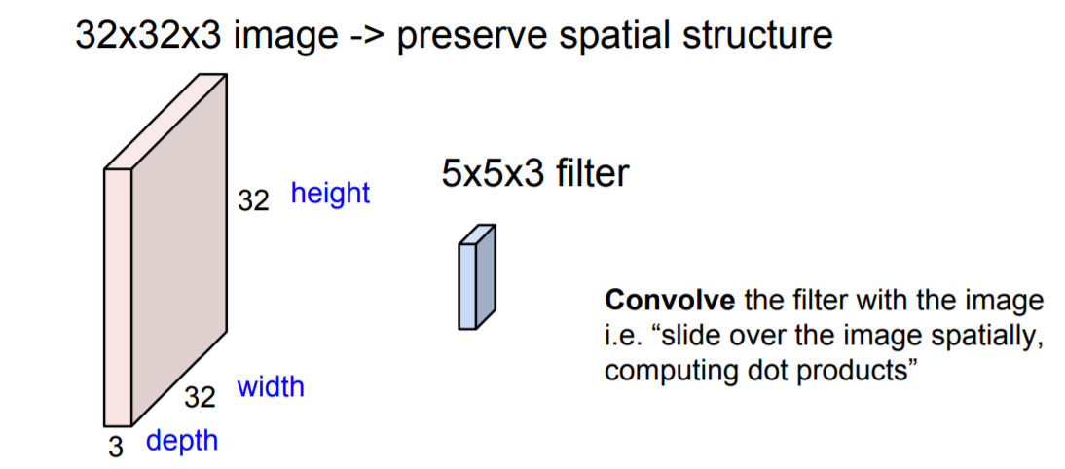
Convolution Layer

Slide 30

Review: Convolution

Slide 31
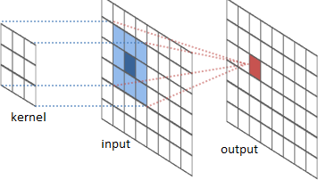
The convolution operation

Slide 32
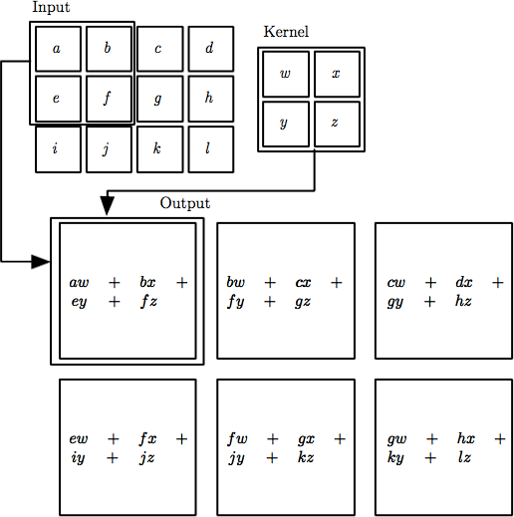

The convolution operation
Local Connectivity. Neurons will connect to only a local region of the input volume.
The spatial extent of this connectivity is a hyperparameter called the receptive field of the neuron (equivalently this is the filter size).
Feature map or output: 28*28 ->3*3 -> map size?

Slide 33
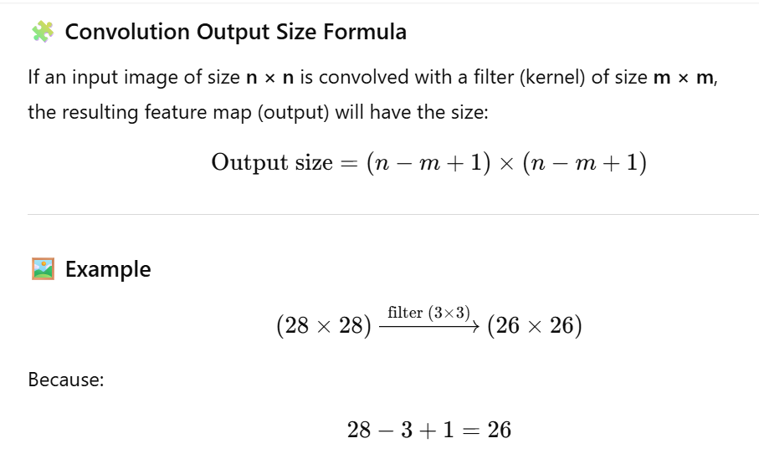
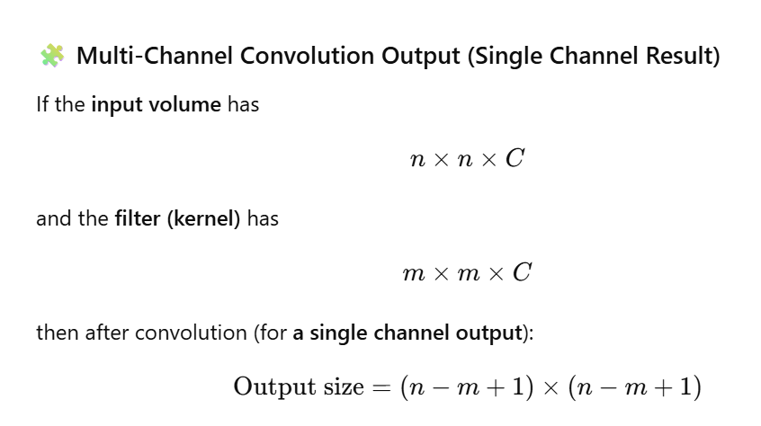

Slide 34
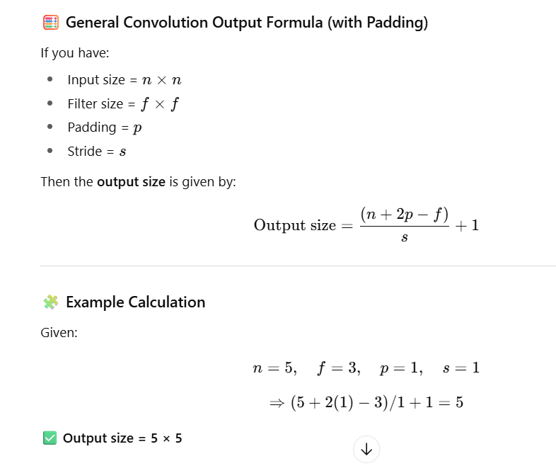
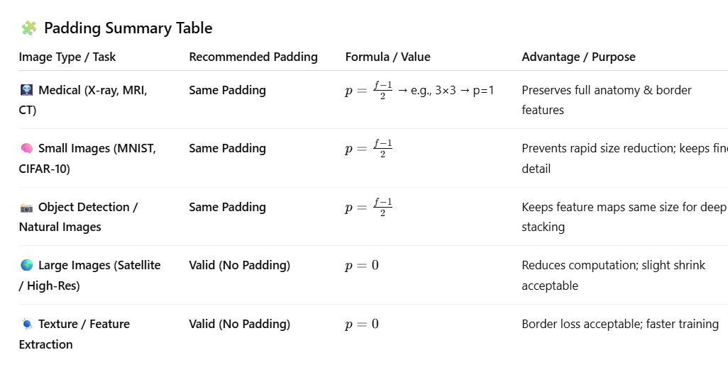

Slide 35
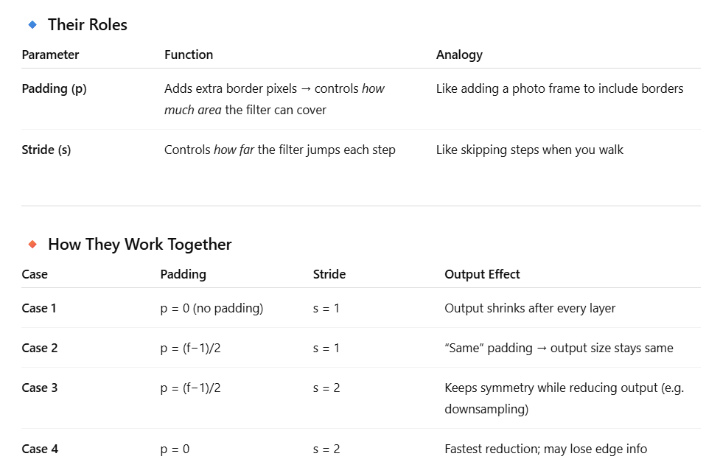
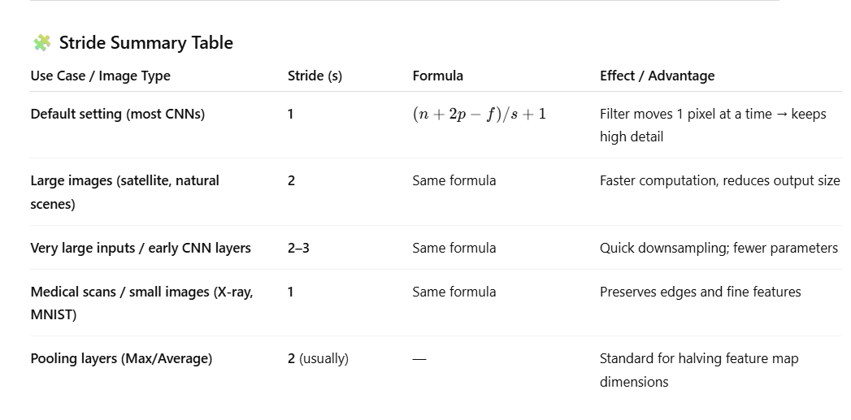

Slide 36
Convolution Layer
32x32x3 image
32
height
32
depth
width
3

Slide 37
Convolution Layer
32x32x3 image
5x5x3 filter
32
Convolve the filter with the image
i.e. “slide over the image spatially, computing dot products”
32
3

Slide 38
Convolution Layer
Filters always extend the full
32x32x3 image
depth of the input volume
5x5x3 filter
32
Convolve the filter with the image
i.e. “slide over the image spatially, computing dot products”
32
3

Slide 39

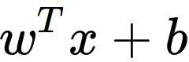
Convolution Layer
32x32x3 image 5x5x3 filter
32
1 number:
the result of taking a dot product between the filter and a small 5x5x3 chunk of the image
(i.e. 5*5*3 = 75-dimensional dot product + bias)
32
3

Slide 40
Convolution Layer
activation map
32x32x3 image 5x5x3 filter
32
28
convolve (slide) over all spatial locations
32
28
3
1

Slide 41
Convolution Layer
32x32x3 image 5x5x3 filter
activation maps
32
28
convolve (slide) over all spatial locations
32
28
consider a second, green filter
3
1

Slide 42
For example, if we had 6 5x5 filters, we’ll get 6 separate activation maps:
activation maps
32
28
Convolution Layer
32
28
3
6
We stack these up to get a “new image” of size 28x28x6!

Slide 43
Preview: ConvNet is a sequence of Convolutional Layers, interspersed with activation functions
32
28
24
….
CONV, ReLU
e.g. 6 5x5x3 filters
CONV, ReLU
e.g. 10 5x5x6 filters
CONV, ReLU
32
28
24
3
6
10

Slide 44
Thank You ☺

